Slide 1
Lab #3
Electrical Power Subsystem (EPS)

Slide 2
Intro
Solar panels are the central component of the Electrical Power System (EPS) for earth-orbiting spacecraft. In this lab you’ll gain a practical understanding of how solar panels work.
You will test KestrelSAT's solar panel array to determine if it will generate enough power to satisfy mission requirements.
You will measure the voltage and current generated by the solar array at various voltages to generate an I-V plot. You will collect two sets of I-V measurements, one for a series-connected array and one for a parallel-connected array.
You will also record solar illuminance with a luxmeter at the time of your power measurements in order to facilitate analysis.
Authorized Resources - PRELAB
Prelab turn-in is individual effort
Generative AI Level 0 Allowed (GenAI not allowed)
Astro 331 course notes/ instructor
Intro
Reference
Prelab
Task 0
Task 1
Task 2
Task 3
Turn-in Reqt’s
Authorized Resources – LAB & LAB REPORT
Lab activities & lab report are team effort
Any non-human resource
Generative AI Level 3 Allowed
Astro 331 course notes/instructor
Objectives:
Understand fundamentals of EPS via practical experimentation.
Gain hands-on power system measurement skills.
Calculate EPS power budget.
Analyze EPS data and report results.

Slide 3
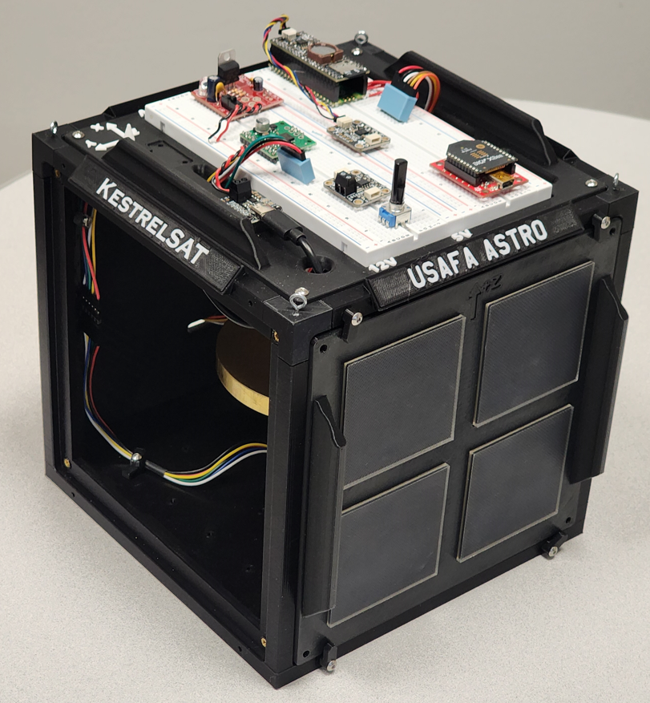
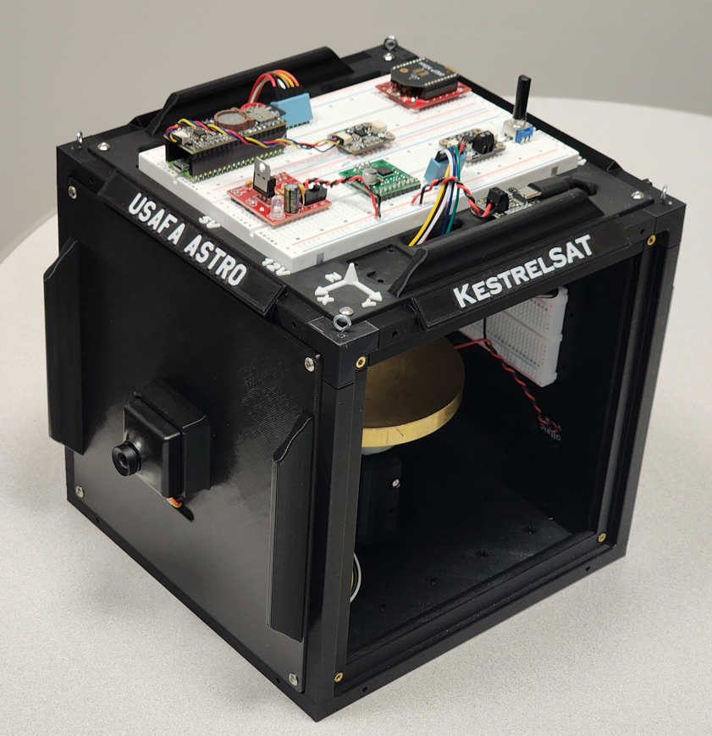
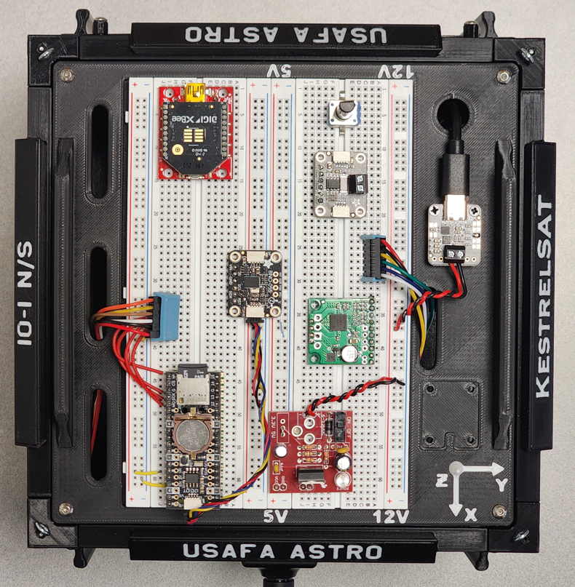
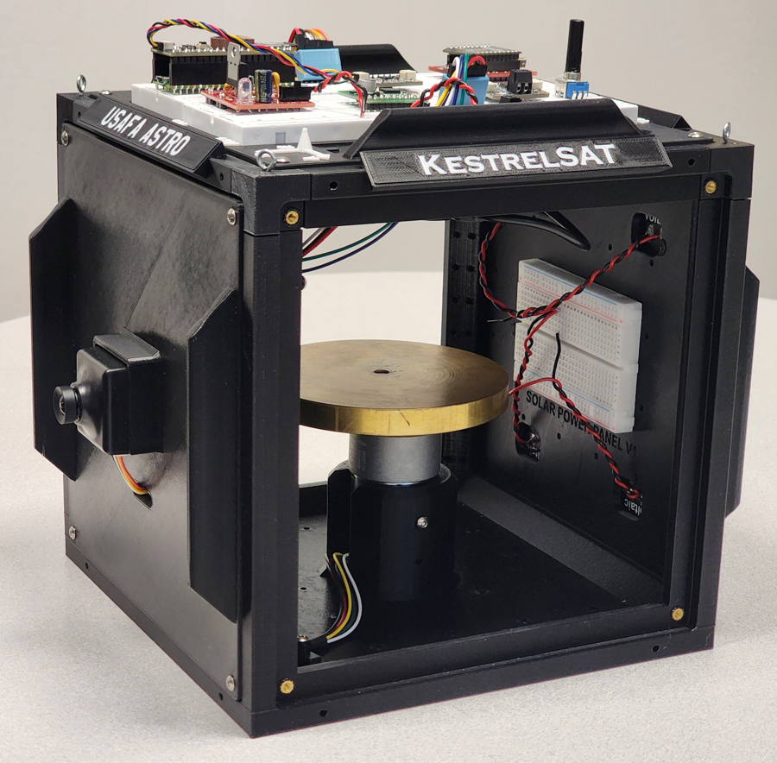
KestrelSAT Overview
Intro
Reference
Prelab
Task 0
Task 1
Task 2
Task 3
Turn-in Reqt’s
Solar Power Side
Reaction Wheel
Camera Side
Solar Power
V & I Sensor
Comm (Xbee transceiver)
Battery Controller
IMU (BNO055)
Motor Driver
MCU (Rpi Pico)
Memory (SD)
Real-Time Clock
12V DC to 5V DC Regulator

Slide 4
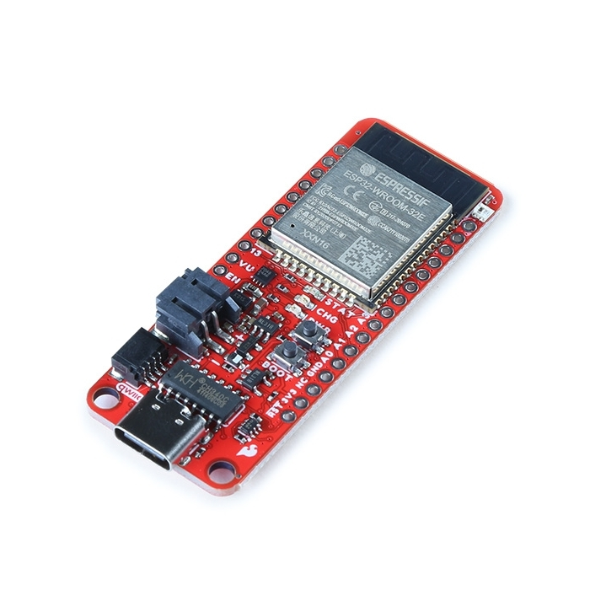
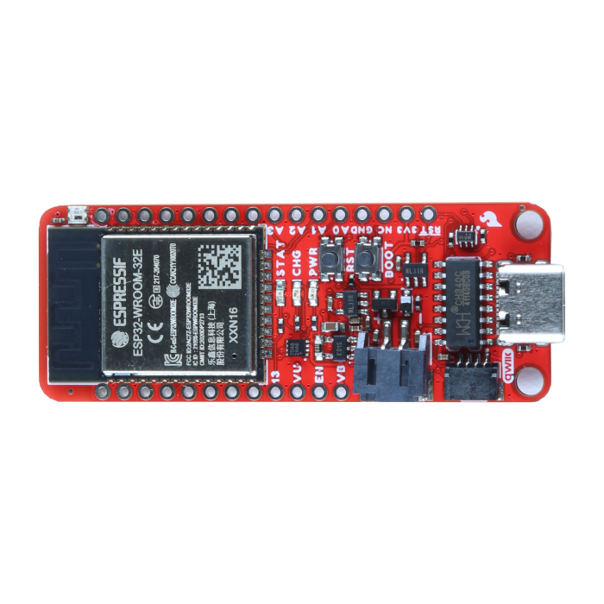
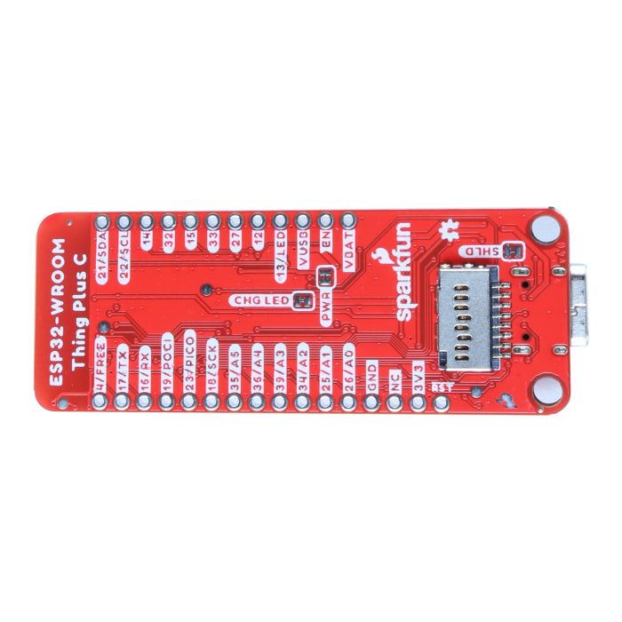
KestrelSAT MCU: ESP32 WROOM
KestrelSAT uses an Espressif ESP32 WROOM MCU on a Sparkfun Thing Plus breakout board.
Features:
Xtensa® Dual-Core 32-bit LX6 Microprocessor (up to 240MHz)
448KB of ROM and 520KB SRAM, 16MB of Embedded SPI flash storage
21 Multifunctional GPIO, Up to thirteen 12-bit ADC Channels
Up to sixteen PWM outputs, Up to two DAC channels
Integrated 802.11b/g/n WiFi 2.4GHz transceiver
Integrated dual-mode Bluetooth® (classic and BLE®)
MAX17048 Fuel Gauge
Intro
Reference
Prelab
Task 0
Task 1
Task 2
Task 3
Turn-in Reqt’s
LEDs
PWR - Red power LED
CHG - Yellow battery charging indicator
STAT - Blue status LED (user-programable)
WS2812 RGB LED (user-programable)
Connectors
USB-C Connector
2-pin JST Connector for a LiPo Battery
4-pin JST Qwiic Connector
SD Card Slot
WARNING
This MCU is a 3.3V microcontroller. DO NOT apply >3.3V (i.e. 5V or 12V) to any pin on the device, except:
- 5V via the USB connecter (i.e. power from laptop or 5V charger)
- 5V to VUSB pin
- Up to 4.2V to VBAT pin
Product Page
Tutorial

Slide 5
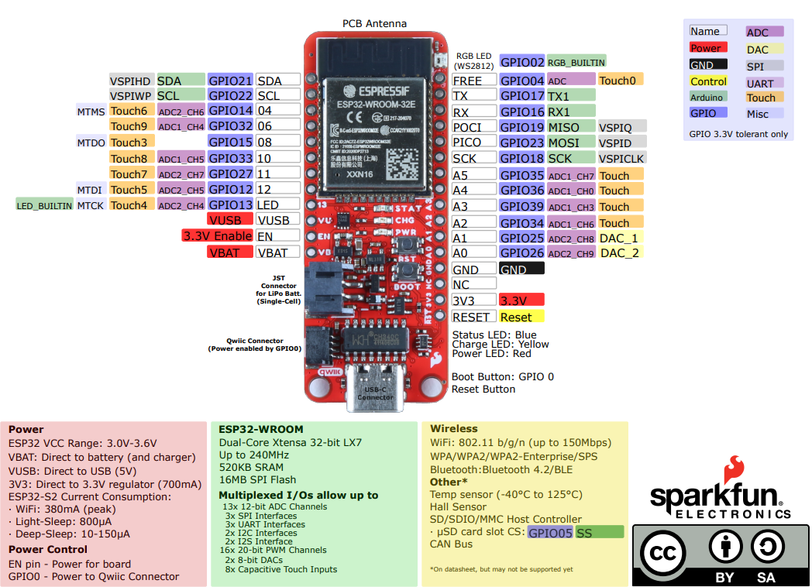
ESP32 Thing Plus Pinout Diagram
Intro
Reference
Prelab
Task 0
Task 1
Task 2
Task 3
Turn-in Reqt’s

Slide 6
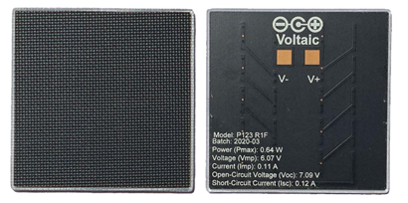
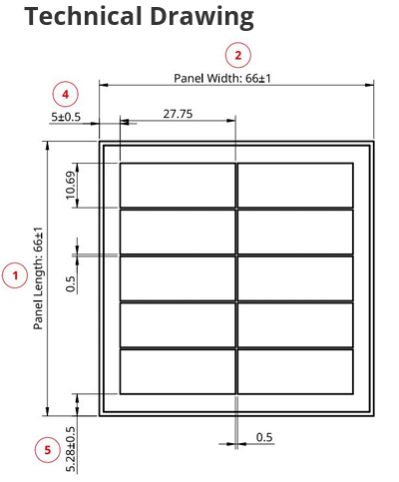
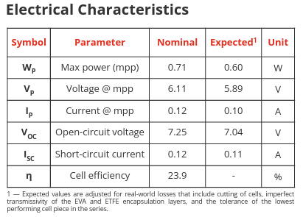
KestrelSAT Solar Panel Reference
*Data listed is for single cell*
Intro
Reference
Prelab
Task 0
Task 1
Task 2
Task 3
Turn-in Reqt’s
Solar Panel Datasheet
Solar Panel Product Page

Slide 7
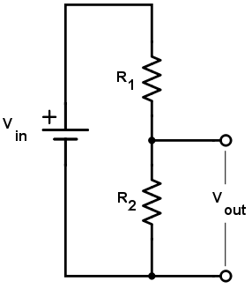
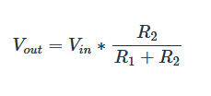

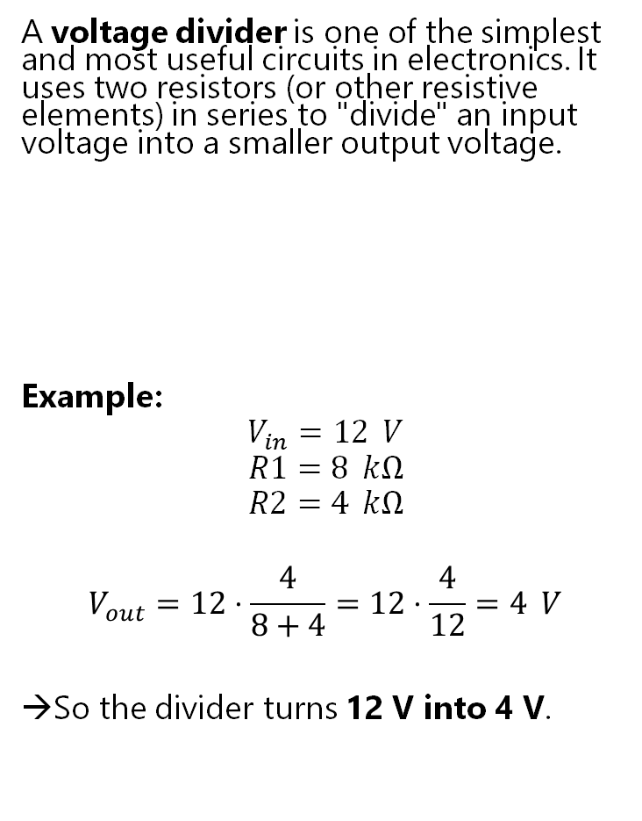
Reference – Voltage Divider
Intro
Reference
Prelab
Task 0
Task 1
Task 2
Task 3
Turn-in Reqt’s
A voltage divider is one of the simplest and most useful circuits in electronics. It uses two resistors (or other resistive elements) in series to "divide" an input voltage into a smaller output voltage.
Example:
$$V_{in}=12 V$$
$$R1=8 kΩ$$
$$R2=4 kΩ$$
$$V_{out}=12⋅\frac{4}{8+4}=12⋅\frac{4}{12}=4 V$$
→So the divider turns 12 V into 4 V.
Warning
Voltage dividers are not good for powering loads because any current drawn from V_{out} changes the resistor ratios (and the voltage drops). They’re best used for signal-level applications, not as actual power supplies.

Slide 8
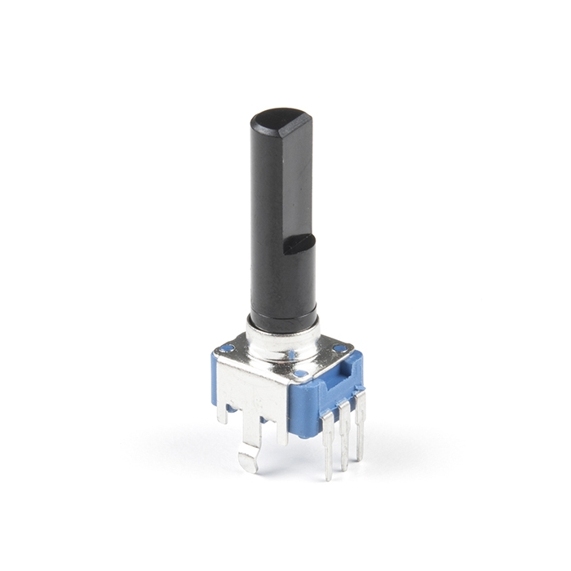
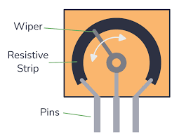
Reference – Potentiometer
Intro
Reference
Prelab
Task 0
Task 1
Task 2
Task 3
Turn-in Reqt’s
A potentiometer (often called a pot) is a three-terminal variable resistor that you can adjust to control voltage or resistance in a circuit. It’s basically a resistor with a sliding or rotating contact (called the wiper) that moves along a resistive track.
Structure
Two outer terminals: connected to the ends of a resistive element.
One middle terminal (wiper): slides along the resistive track and “taps” into it at any point.
How it Works
If you connect the outer two terminals across a voltage source, the wiper outputs a variable fraction of that voltage (like a voltage divider).
If you use just one outer terminal and the wiper, the potentiometer acts as a variable resistor (rheostat).

Slide 9
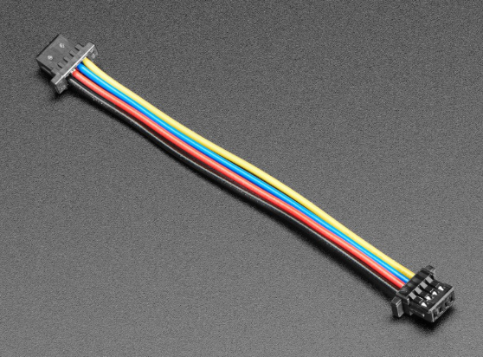

Reference – I²C Communication Bus & STEMMA QT
SDA
V+
I²C is a two-wire serial communication protocol designed for short-distance communication between chips on the same board. It is used for connecting things like sensors, displays, EEPROMs, and peripherals to a microcontroller.
SDA (Serial Data) – carries the data
SCL (Serial Clock) – provides the timing for data transfer
It uses a Master–Slave protocol:
The master (usually a microcontroller) generates the clock and starts communication.
Slaves (sensors, displays, etc.) each have a 7-bit or 10-bit address that identifies them on the bus.
Multiple devices can share the same two wires.
Master sends an address, and only the device with that address responds.
---------------------------------------------------------------------
STEMMA QT is a plug-and-play I²C connection standard using 4-pin JST-SH connectors
Black for Ground GND
Red for Supply voltage V+ (typically 3.3 V, sometimes 5 V)
Blue for SDA (I²C data line)
Yellow for SCL (I²C clock line)
SCL
GND
Intro
Reference
Prelab
Task 0
Task 1
Task 2
Task 3
Turn-in Reqt’s
MCU (Master)
Rp
Sensor 1 (Slave)
Sensor 2 (Slave)
Rp
Sensor 3 (Slave)
Rp = Pullup Resistor (~2.2K$Ω$ to 10K$Ω$)
STEMMA QT Connector
Adafruit Tutorial

Slide 10
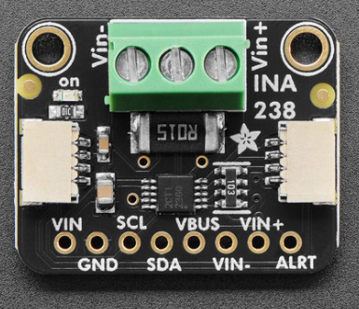
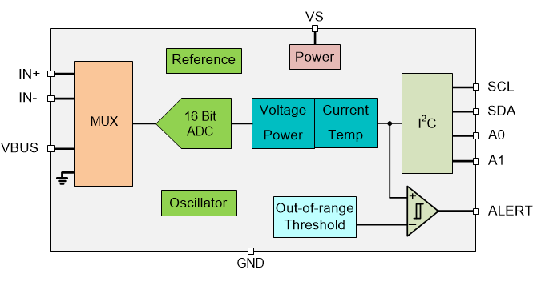
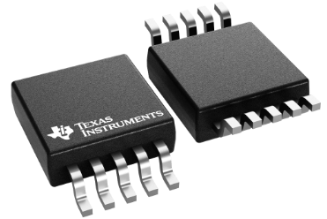
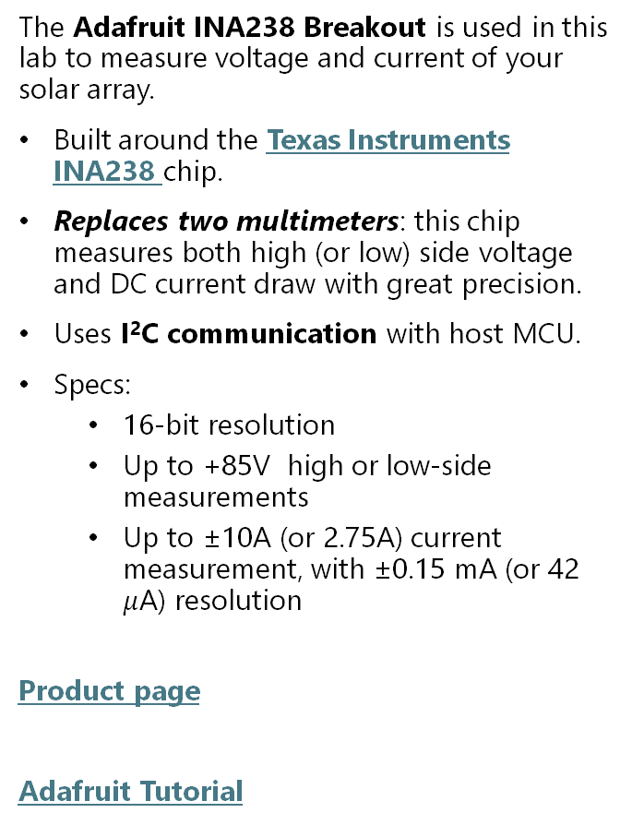
Reference – Adafruit INA238 Breakout
Intro
Reference
Prelab
Task 0
Task 1
Task 2
Task 3
Turn-in Reqt’s
The Adafruit INA238 Breakout is used in this lab to measure voltage and current of your solar array.
Built around the Texas Instruments INA238 chip.
Replaces two multimeters: this chip measures both high (or low) side voltage and DC current draw with great precision.
Uses I²C communication with host MCU.
Specs:
16-bit resolution
Up to +85V high or low-side measurements
Up to ±10A (or 2.75A) current measurement, with ±0.15 mA (or 42 $μ$A) resolution
Product page
Adafruit Tutorial
Simplified Schematic

Slide 11
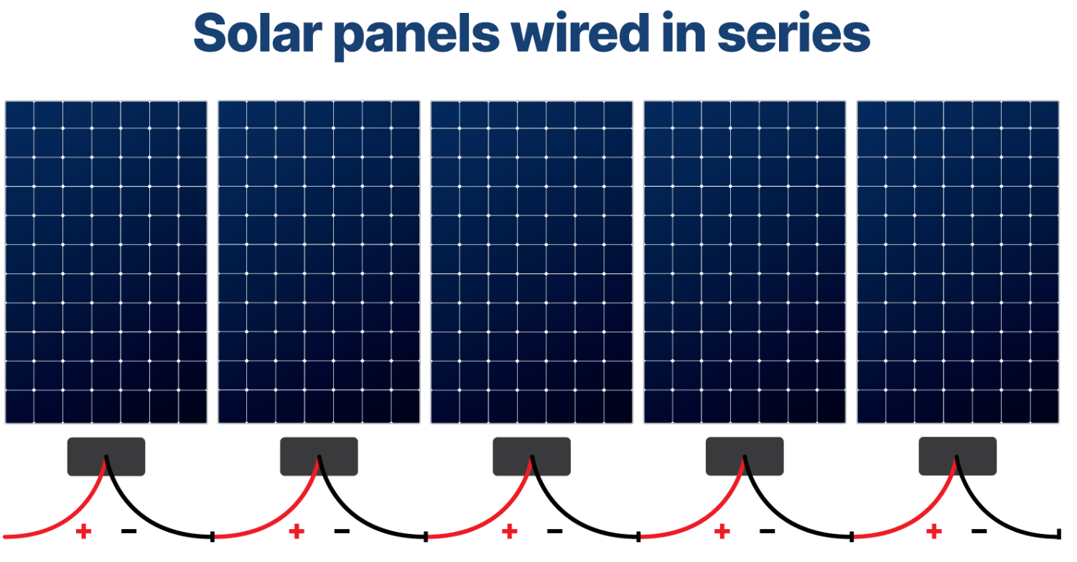
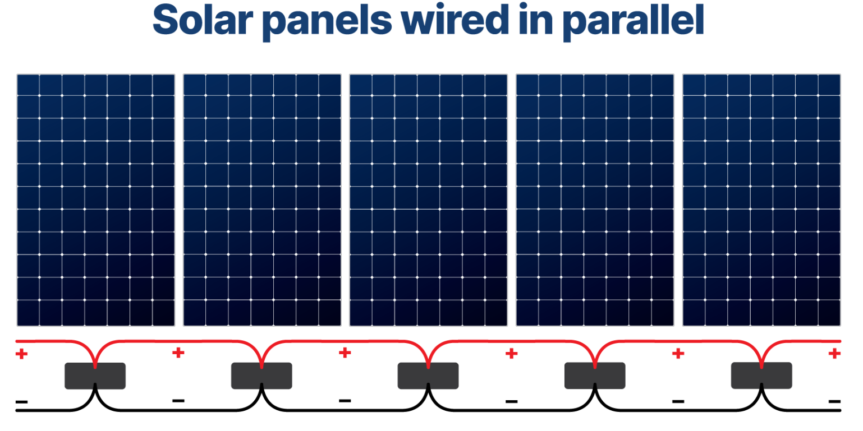
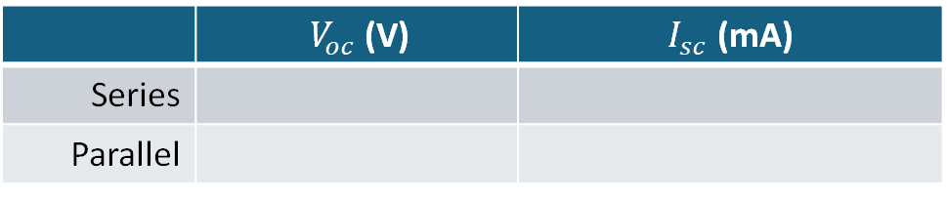

Prelab Data Collection
Using the breadboard on the back of KestrelSAT’s solar power side, connect the four solar panels in a Series Array.
Take your array outside and record the Solar luminance in Lux.
Measure and record the short-circuit current (max current, $I_{sc}$) of your solar array.
Measure and record the open-circuit voltage (max voltage,${ V}_{oc}$) of your solar array.
Reconnect KestrelSAT’s solar panels in a Parallel Array.
Repeat Steps 3-4.
Intro
Reference
Prelab
Task 0
Task 1
Task 2
Task 3
Turn-in Reqt’s
Solar Luminance (Lux)
 | ${ V}_{oc}$ (V) | $I_{sc}$ (mA)
Series
Parallel

Slide 12
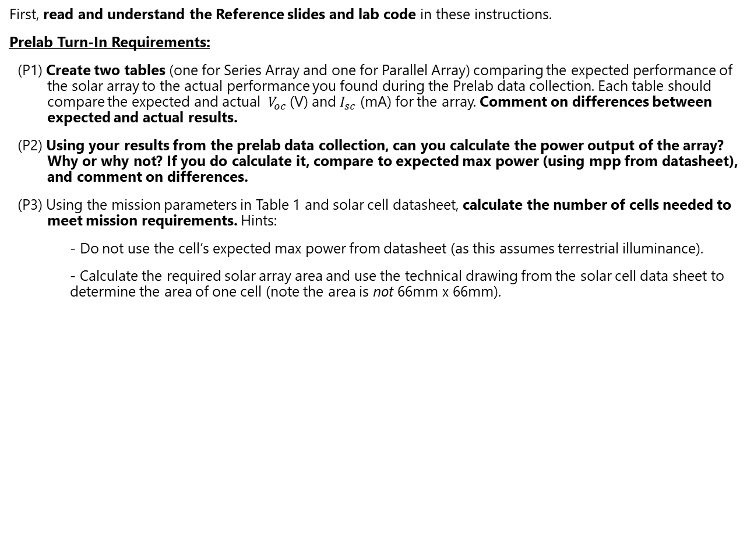
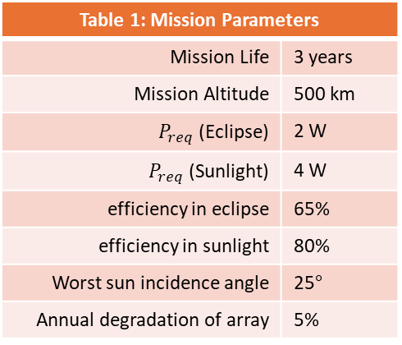
Prelab Tasks
Intro
Reference
Prelab
Task 0
Task 1
Task 2
Task 3
Turn-in Reqt’s
First, read and understand the Reference slides and lab code in these instructions.
Prelab Turn-In Requirements:
(P1) Create two tables (one for Series Array and one for Parallel Array) comparing the expected performance of the solar array to the actual performance you found during the Prelab data collection. Each table should compare the expected and actual ${ V}_{oc}$ (V) and $I_{sc}$ (mA) for the array. Comment on differences between expected and actual results.
(P2) Using your results from the prelab data collection, can you calculate the power output of the array? Why or why not? If you do calculate it, compare to expected max power (using mpp from datasheet), and comment on differences.
(P3) Using the mission parameters in Table 1 and solar cell datasheet, calculate the number of cells needed to meet mission requirements. Hints:
- Do not use the cell’s expected max power from datasheet (as this assumes terrestrial illuminance).
- Calculate the required solar array area and use the technical drawing from the solar cell data sheet to determine the area of one cell (note the area is not 66mm x 66mm).
Table 1: Mission Parameters
Mission Life | 3 years
Mission Altitude | 500 km
$P_{req}$ (Eclipse) | 2 W
$P_{req}$ (Sunlight) | 4 W
efficiency in eclipse | 65%
efficiency in sunlight | 80%
Worst sun incidence angle | 25$°$
Annual degradation of array | 5%
Turn-In Format
Provide answers to (P1)/(P2)/(P3) digitally using Word, PowerPoint, or LaTeX.
Math work for (P3) may be handwritten. If it is, make sure it is legible/organized and include a high-quality scan of it in your turn-in file.
Include a documentation statement.
Authorized Resources
Prelab turn-in is individual effort
Generative AI Level 0 Allowed (GenAI not allowed)
Astro 331 course notes/instructor

Slide 13
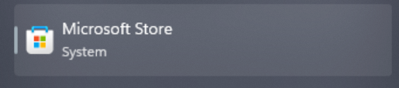


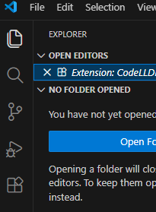
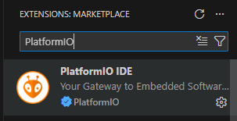
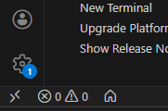
Task 0A – Install VS Code + Platform IO
Intro
Reference
Prelab
Task 0
Task 1
Task 2
Task 3
Turn-in Reqt’s
Open Microsoft Store & install Visual Studio Code.
(2) Open VS Code and Click ‘Extensions’ (shortcut: CTRL+SHIFT+X)
(3) Search for and Install “PlatformIO IDE”
(4) PlatformIO can be started via the Alien symbol on the left side panel.
(5) After PlatformIO starts, there should be a home icon in lower left corner that takes you to ‘PIO Home’ tab. From that tab you can start/open projects, search for libraries, etc.

Slide 14
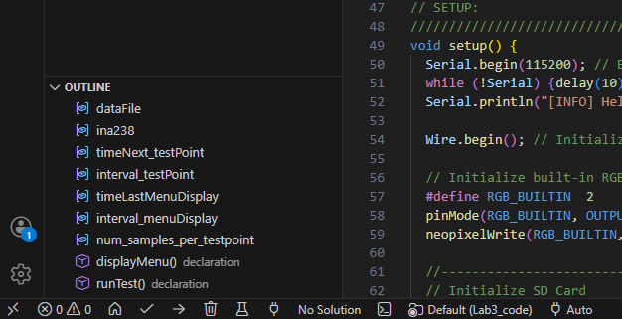
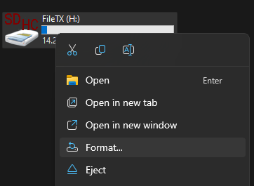
Task 0B – Setup
Download Astro331_Lab3_Code folder from Teams or Instructor USB drive.
(2) Open the code in PlatformIO
(3) Connect your computer to the KestelSAT MCU via a USB-C cable and upload the code to KestrelSAT.
(3) Format SD Card and install the card in KestrelSAT
Insert SD card and navigate to “This PC”
Right-click SD drive and select “Format…”
Use default options to format
Intro
Reference
Prelab
Task 0
Task 1
Task 2
Task 3
Turn-in Reqt’s
Error 2 during upload of code to your MCU?
Try holding down the boot button on the MCU and re-uploading.

Slide 15

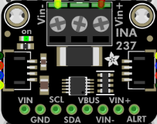
Task 1— Connect the INA238 Breakout
In this lab, a 10 Kohm potentiometer will be used to simulate a variable load resistance. When the potentiometer’s wiper is set to one extreme, we simulate a short circuit, and the other extreme an open circuit. This facilitates construction of an IV curve for the array.
Intro
Reference
Prelab
Task 0
Task 1
Task 2
Task 3
Turn-in Reqt’s
Solar Array +
Warning
Always make sure to connect grounds for all devices!
In addition to wiper of the potentiometer, the ground of the solar array must be connected to the common ground of the MCU/INA219.
Note: the ground of the INA219 is connected to the MCU via the STEMMA cable.
Potentiometer
I2C STEMMA QT Connector to MCU
Solar Array -
Connections:
Solar Array + → VIN+ on INA238 breakout
Load (potentiometer left or right pin) → VIN- on INA238 breakout.
Ground of Solar Array to wiper of potentiometer.
Ground of Solar Array to common ground of MCU.
This setup ensures the current flows through the onboard shunt resistor so the INA238 can measure it.
Ground symbol

Slide 16
Task 2 – Collect IV Data with INA238
In this task, you’ll collect IV data for your solar array in sunlight for both parallel and series configurations.
Intro
Reference
Prelab
Task 0
Task 1
Task 2
Task 3
Turn-in Reqt’s
Using the breadboard on the back of KestrelSAT’s solar power side, connect the four solar panels in a parallel array. Connect this array to the INA238 as in Task 1.
Take your KestrelSAT and laptop outside and record the Solar luminance in Lux.
→The measured value may jump around, try to take an average value.
Conduct a test run to gather IV data:
(3.1) During the run, slowly turn the potentiometer end-to-end.
See next slide for options to save your data.
Disconnect power from the MCU.
Reconnect KestrelSAT’s solar panels in a series array.
Repeat Steps 2-4.

Slide 17
Task 2 (cont) – Saving IV Data
There are several options to save the IV data from KestrelSAT that you will use for your lab report:
Intro
Reference
Prelab
Task 0
Task 1
Task 2
Task 3
Turn-in Reqt’s
Via the KestrelSAT Ground Control Station Software:
Data from the Serial Monitor can be logged continuously (real time) using the “Start Logging Button” (top right). ← Saves everything in Serial Monitor from time recording starts to stops
A log of everything in the Serial Monitor can be saved using the “Save Log” button (bottom left of “Connection” tab). ← Saves everything in Serial Monitor
Via the Plot: right-click on the plot and select “Export..”. “Select CSV of Original Plot Data” (note there are other options to export pictures of the plot as well). ← Only saves data points currently display on Plot
Via the SD card onboard the KestrelSAT MCU: KestrelSAT records a new .csv file of data every time a test is run. Carefully remove the SD card and retrieve the .csv file from it for the desired test run.

Slide 18
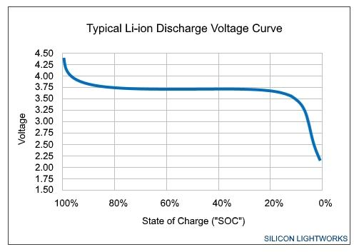
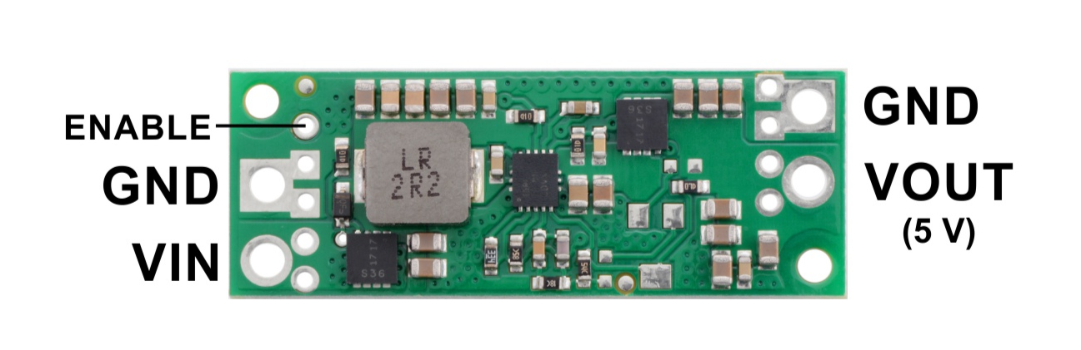
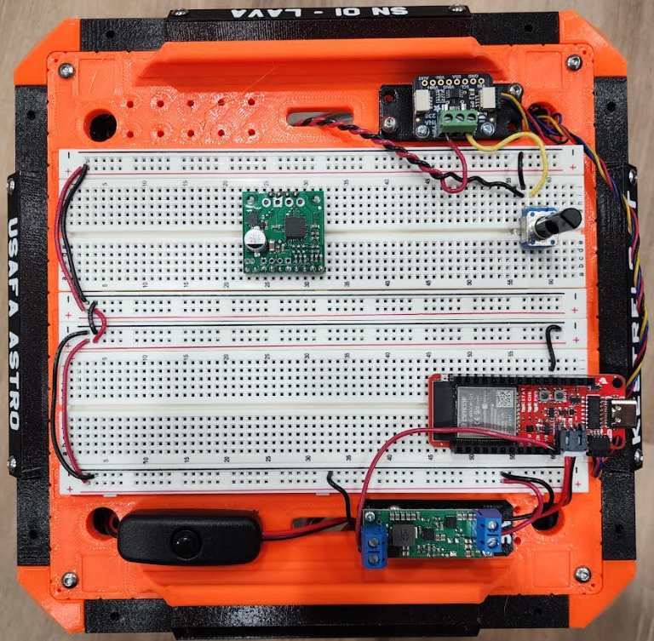
Task 3 – Finish Setting Up KestrelSAT EPS
In this task you will prepare for future labs by completing setup of the electrical power system for your KestrelSAT.
Using a multimeter, measure the voltage of your KestrelSAT battery. Discuss with your instructor how to estimate the state of charge of the battery.
Install the battery and connect it to the female end of the power switch. Connect the male end of the power switch to the battery connector on your MCU. Confirm you can power on your KestrelSAT with the power switch.
Link all power rails on your breadboard together using red and black jumper wires (red for + and black for -).
Connect a black wire from MCU ground pin to the ground rail.
Connect the VBAT to the VIN terminal of the 5V Step-Up Regulator. Connect a black or brown wire from the ground rail to ground of the regulator.
With KestrelSAT powered on, confirm the regulator provides 5V on the VOUT pin. Connect VOUT to the + power rail. All power rails on the breadboard are now 5V potential.
Intro
Reference
Prelab
Task 0
Task 1
Task 2
Task 3
Turn-in Reqt’s
5V Step-Up Voltage Regulator U3V70F5
(3)
(4)
(5)
(2)

Slide 19
Lab Report #1 Guidance
The turn-in for this lab is a formal lab report. Reference the DFAS Writing Guide of Teams and the Astro 331 Lab Template here:
https://www.overleaf.com/read/dpkvjmphdmwt#dfdc56
For the Theory and Theoretical Predictions sections, use your Prelab content.
Be sure to include the following in your Experimental Results and Discussion sections:
Clean plots of IV data for Serial and Parallel. Discussion of data. Compare to expected from datasheet. Identify the open-circuit voltage, short-circuit current, and peak power point on your plot. Make sure that you have title and axis labels with units.
Plot of power (recall 𝑃 = 𝐼𝑉) for both serial and parallel. Analyze and discuss differences.
Using your measured peak power and measured incident illuminance collected with the luxmeter, calculate the measured efficiency of your solar array.
Intro
Reference
Prelab
Task 0
Task 1
Task 2
Task 3
Turn-in Reqt’s

Slide 20
Deprecated Slides
(For reference only)
Notes:
Old Prelab Report Guidance: https://www.overleaf.com/read/vzjvwdkjhvrh#5be3f8 ← DEPRECATED (DO NOT USE, FOR INSTRUCTOR REFERENCE ONLY)

Slide 21
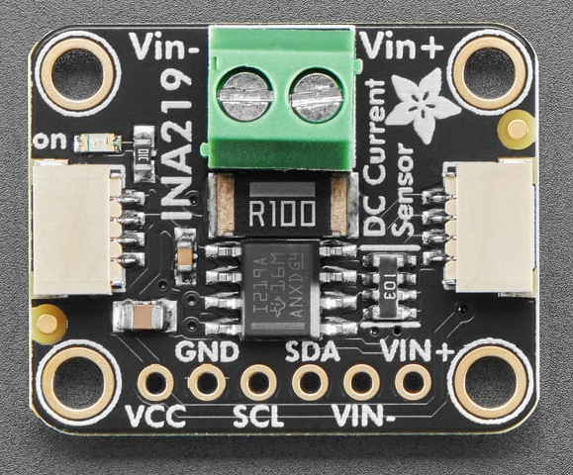
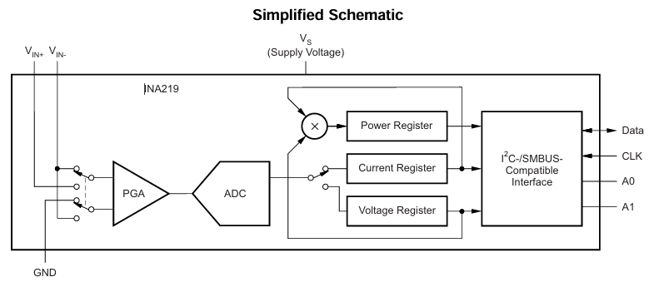
Reference – Adafruit INA219 Breakout
Intro
KestrelSAT
Prelab
Reference
Task 0
Task 1
Task 2
Task 3
Turn-in Reqt’s
The Adafruit INA219 Breakout is used in this lab to measure voltage and current of your solar array.
Built around the Texas Instruments INA219 chip.
Replaces two multimeters: this chip measures both high side voltage and DC current draw with 1% precision.
Uses I²C communication with host MCU.
Specs:
Up to +26V target voltage
Up to ±3.2A current measurement, with ±0.8mA resolution
Product page
Adafruit Tutorial

Slide 22
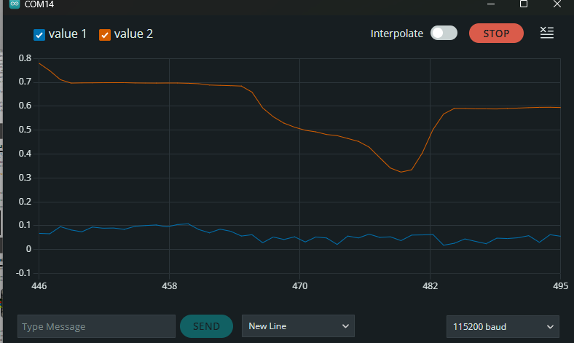
Task 2 – Upload and Test Code
Intro
Reference
Prelab
Task 0
Task 1
Task 2
Task 3
Turn-in Reqt’s
Open Astro331_Lab3_Code.ino in the Arduino IDE.
Connect KestrelSAT’s Raspberry Pi Pico to your computer via USB.
Select the correct board (Raspberry Pi Pico) and port.
Upload your code.
Open serial monitor.
Send ‘S’ to start a test run.
Use the Serial Plotter to observe the INA219 current and voltage data from your solar array.
Confirm the data changes as you rotate the potentiometer.
Stop the test by sending ‘X’ in the Serial monitor.
Send ‘P’ and select the file for the test you just ran. Confirm the .csv data looks good.
Notes:
INA219 code reference:
shuntvoltage = ina219.getShuntVoltage_mV();
busvoltage = ina219.getBusVoltage_V();
current_mA = ina219.getCurrent_mA();
loadvoltage = busvoltage + (shuntvoltage / 1000);
What each variable means
shuntvoltage → the voltage drop (in mV) across the 0.1 Ω sense resistor.
Ohm’s law: $V=I×R$.
If current is flowing, this will be some small positive or negative value depending on current direction.
busvoltage → the voltage that the INA219 measures at the VIN– pin, i.e. after the shunt resistor.
This is the "downstream" voltage that the load actually sees.
Range: 0–26 V.
loadvoltage → the calculated supply voltage going into the load, i.e. before the shunt resistor.
Formula:
$$V_{LOAD}=V_{BUS}+V_{SHUNT}$$
Here, busvoltage is at the load side, and shuntvoltage is the drop across the resistor.
Dividing by 1000 just converts mV → V.
current_mA → the INA219 calculates this by taking $V_{SHUNT}/R_{SHUNT}$.
With the default 0.1 Ω resistor:
$$I\left(mA\right)=\frac{V_{SHUNT}\left(mV\right)}{0.1 Ω}$$
Why compute loadvoltage?
If you only look at busvoltage, you’re seeing the reduced voltage after the shunt resistor. But in most systems, you care about the actual supply voltage being applied to the load.
Example: Suppose you have a 12.00 V battery powering a 1 A load.
The 0.1 Ω resistor drops $0.1 Ω×1 A=0.1 V$.
INA219 measures:
shuntvoltage = 100 mV
busvoltage = 11.90 V
loadvoltage = 11.90 + 0.10 = 12.00 V (the true battery output).
In short: loadvoltage is the upstream supply voltage, reconstructed from the downstream bus voltage + the voltage drop across the shunt.

